Slide 1
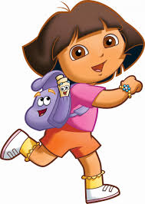
PEA – 516
Lecture- 15
Simple Interest

Slide 2
Principal
The money borrowed or lent out for a certain period is called the principal or the sum.
Interest
Extra money paid for using other's money is called interest.
Simple Interest
If the interest on a sum borrowed for certain period is reckoned uniformly, then it is called simple interest.

Slide 3
If P= Rs.1000, R=10% p.a. T=3 years. Find Simple Interest for 3 years.

Slide 4
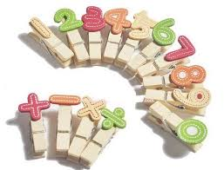
Let Principal = P, Rate = R% per annum (p.a.)
and Time = T years. Then
Simple Interest =(P x R x T)/100

Slide 5
Question: Reena took a loan of Rs. 1200 with simple interest for as many years as the rate of interest. If she paid Rs. 432 as interest at the end of the loan period, what was the rate of interest?
[A] 3.6
[B] 6
[C] 18
[D] Can not be determined

Slide 6
Question: A man took loan from a bank at the rate of 12% p.a. simple interest. After 3 years he had to pay Rs. 5400 interest only for the period. The principal amount borrowed by him was:
[A] Rs.2000
[B] Rs.10000
[C] Rs.15000
[D] Rs.20000

Slide 7
Question: How much time will it take for an amount of Rs. 450 to yield Rs. 81 as interest at 4.5% per annum of simple interest?
[A] 3.5 years
[B] 4 years
[C] 4.5 years
[D] 5 years

Slide 8
Question: The interest for the 3rd year on a certain sum at a certain rate of simple interest is Rs.3000. find the sum of the interests accrued on it in the 6th, 7th and 8th years.
[A] Rs.6000
[B] Rs.9000
[C] Rs.4500
[D] Rs.12000

Slide 9
Question: A sum was invest for 2 years. It will give Rs. 300 more, if invested at 3% higher rate. Find the sum.
[A] Rs.4000
[B] Rs.5000
[C] Rs.6000
[D] Rs.10000

Slide 10
Question: A sum amounts to Rs.1008 in 2 years and amounts to Rs.1112 in 3 years at SI. Find the sum and rate of interest per annum.
[A] Rs.800, 13% pa
[B] Rs.600, 12 % pa
[C] Rs.800, 12% pa
[D] Rs.600, 13% pa

Slide 11
Question: S.I. On Rs 400 for 5 years together with that on Rs. 600, for 4 year to Rs. 132. If the Rate is same in both the case. Find rate % of interest?
[A] 2% pa
[B] 3% pa
[C] 5% pa
[D] 8% pa

Slide 12
Question: A shopkeeper borrow Rs. 20,000 from two money lenders. For one loan, he paid 12% pa and for other 14% pa. After one year he paid Rs. 2560 as total interest. How much did he borrow each?
[A] Rs.8000, Rs.12000
[B] Rs.12000, Rs.8000
[C] Rs.6000, Rs.14000
[D] Rs.14000, Rs.6000

Slide 13
Question: Rs. 1500 is invested in two such parts that if one part be invested at 6% and other at 5%, S.I= Rs. 85 for one year. Then how much was invested at 5%?
[A] Rs.1000
[B] Rs.500
[C] Rs.600
[D] Rs.800

Slide 14
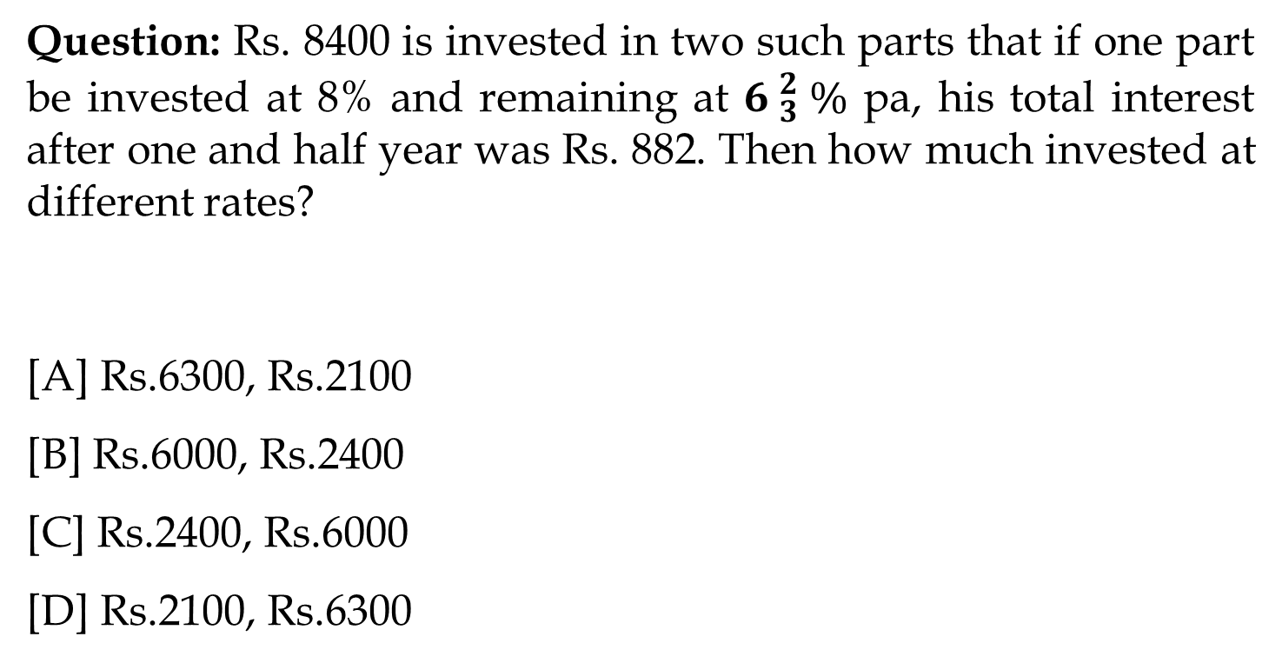
Question: Rs. 8400 is invested in two such parts that if one part be invested at 8% and remaining at ${6 }_{3}^{2} \%$ pa, his total interest after one and half year was Rs. 882. Then how much invested at different rates?
[A] Rs.6300, Rs.2100
[B] Rs.6000, Rs.2400
[C] Rs.2400, Rs.6000
[D] Rs.2100, Rs.6300

Slide 15
Question: Rs. 950 is lend in two ways. The rate of S.I given on one part is 6% and on other part is 4%. If the S.I of 5 years is Rs. 200 then how much is given on 6%?
[A] Rs.500
[B] Rs.400
[C] Rs.200
[D] Rs.100

Slide 16
Question: If a sum of money at simple interest doubles in 6 years, it will become 4 times in:
[A] 12 years
[B] 14 years
[C] 16 years
[D] 18 years

Slide 17
Question: If a sum of money at simple interest doubles in 8 years, it will become 4 times in:
[A] 16 years
[B] 24 years
[C] 64 years
[D] 32 years

Slide 18
Question: Find the present value (in Rs.) of Rs.3000 due after 5 years at 10% p.a. simple interest.
[A] Rs.1500
[B] Rs.1800
[C] Rs.2000
[D] Rs.2500

Slide 19


